Slide 1

Windows Forms- DB Processing
Recording the Main Transaction and the Inner Details of a Transaction for a Book Shop

Slide 2
About these notes!!
These notes contain a demonstration of how to:
record a main Order transaction for a point of sale system (slides 1-16 – also provides a soln to prac 6 – prototype test prac)
Record the inner details of a transaction (not required for the test but certainly required for the Major Project)

Slide 3
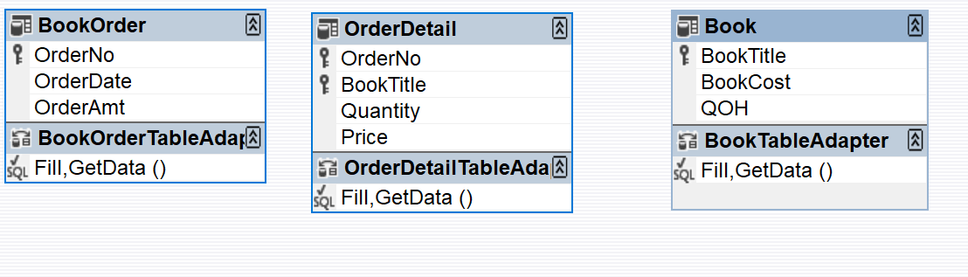
The Book Sale App
The demonstration of the recording of the Inner Detail of a Transaction will be demonstrated via a Book App that is designed to record the sale of books; in this app the Customer details are not required
The Book App consists of the following dataset structure:
Book Order are placed – and each Order consist of many Order Details and each OrderDetail references a single book – we will not implement the relationship in the database (for convenience of avoiding database generated errors)

Slide 4
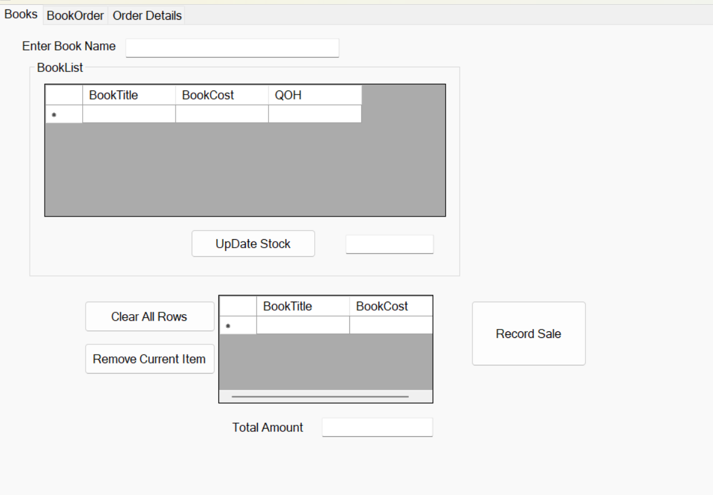
The Interface
Consists of many bits of functionality that is quite self-explanatory – the interface has options to:
Search for a Book
Update Book Stock (QOH)
Add items to an Invoice
Generate the total Amt owing
Record the full Sale
i.e the total Sale Amt and Date
The details of books that will be purchased
Also, you can remove individual items from the Invoice as well as all invoice item

Slide 5
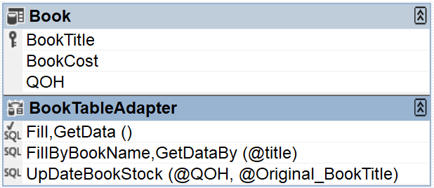
The Search and Update
Update can be done in many ways
Via the Database
Via programming code
We will write methods on the table adapter to:
Search for a Book
SELECT BookTitle, BookCost, QOH
FROM Book
WHERE (BookTitle LIKE + '%' + @title + '%')
Update the Stock of the book
UPDATE Book
SET QOH = QOH + @QOH
WHERE (BookTitle = @Original_BookTitle);

Slide 6
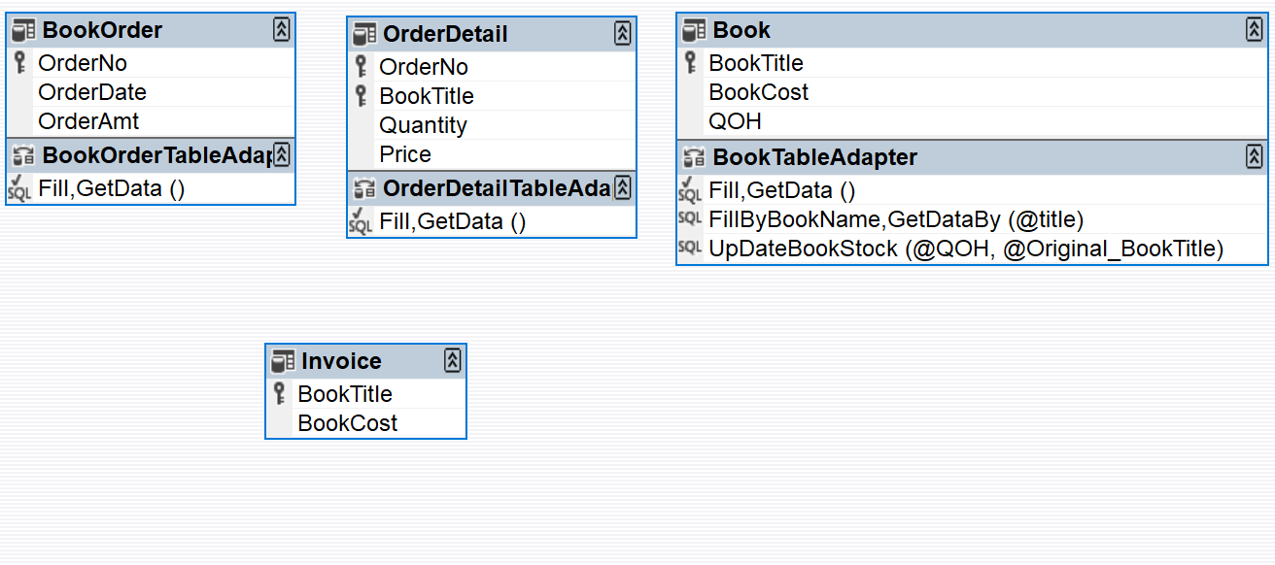
An Invoice DataTable
Add a DataTable to the DataSet and name it Invoice – add on 2 columns (string and decimal) - The BookTitle and BookCost data columns are added on – you need to ensure that the data types match those shown in the Book Table

Slide 7
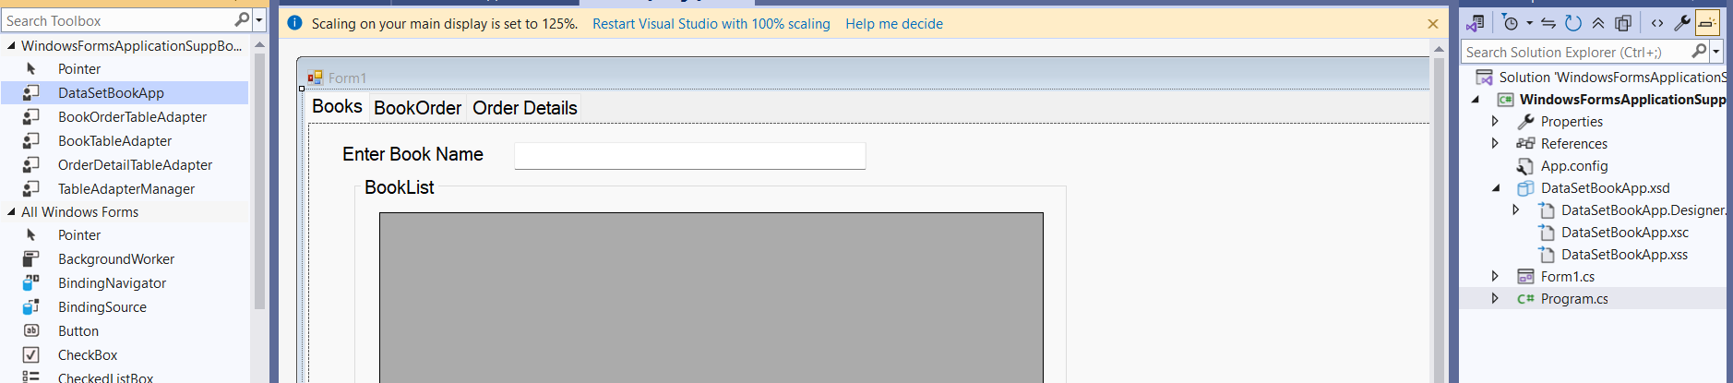
Rebuild the Application to get the Data Adapters
Use the adapters to generate adapter object that can be linked to the Gridview

Slide 8
The Book Data and the Book Search
The code required here is to fill the Gridview with Book Data and to provide a dynamic search option. The code is quite trivial because the SQL functionality has been written on the DataTable inside the DataSet.
private void Form1_Load(object sender, EventArgs e)
{
TABook1.Fill(dsBookApp1.Book);
}
private void txtBookName_TextChanged(object sender, EventArgs e)
{
TABook1.FillByBookName(dsBookApp1.Book, txtBookName.Text);
}

Slide 9
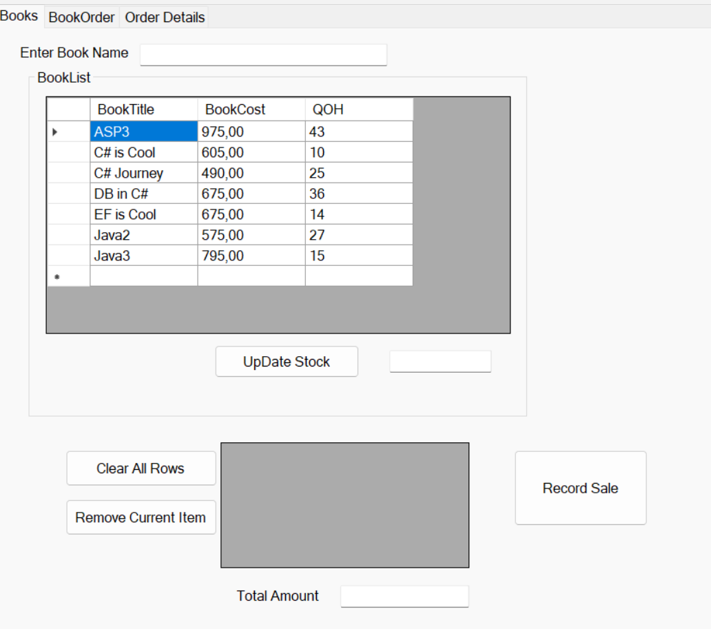
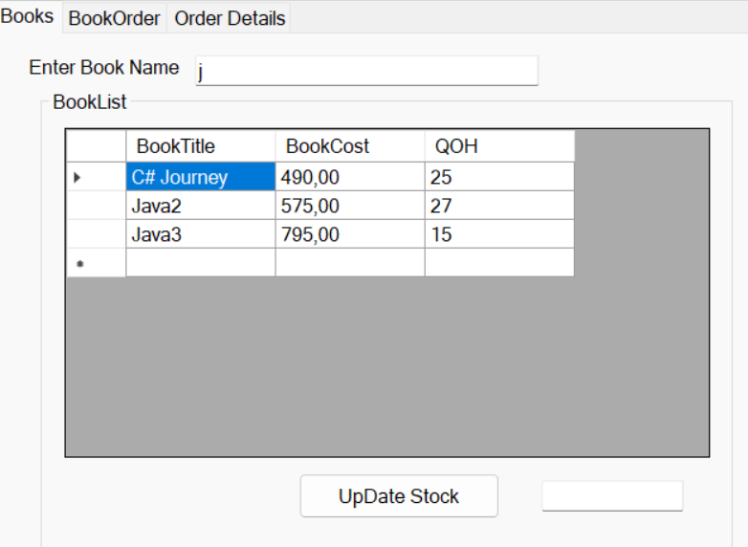
The Display and Search

Slide 10
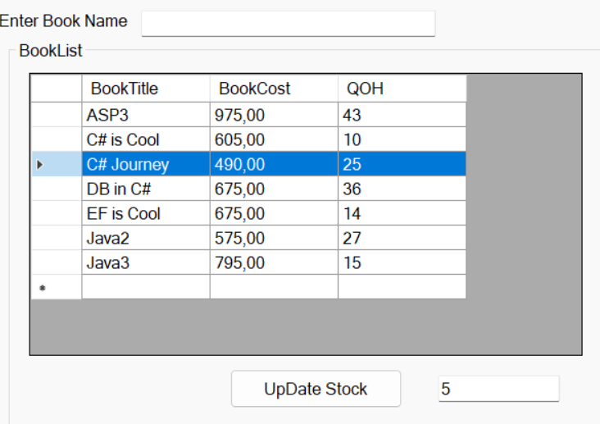
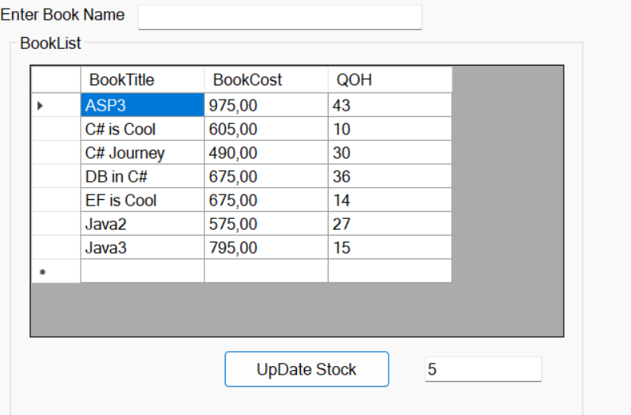
Let us also do the Update of Stock
The functionality has already been created on the DataTable (See slide 4) – we simply have to invoke the method and the update will take place
Also, once the update occurs, you have to refresh the gridview (by filling in all the rows again to see the updated effect)
private void btnStock_Click(object sender, EventArgs e)
{
taBook1.UpDateBookStock(Convert.ToInt32(txtStockAmt.Text), dgvBook.CurrentRow.Cells[0].Value.ToString());
taBook1.FillByBookName(dsBookApp1.Book, txtBookName.Text);
}
The update logic is that for the current row, the QOH will be increased/decreased by the amount entered (-ve amount means decrease) – so if you enter 5 when the cursor is placed in the row for the book named “C# Journey”, then the QOH will change to 30 and the Gridview updates and shows the new value
Update the Stock of the book
UPDATE Book
SET QOH = QOH + @QOH
WHERE (BookTitle = @Original_BookTitle);

Slide 11
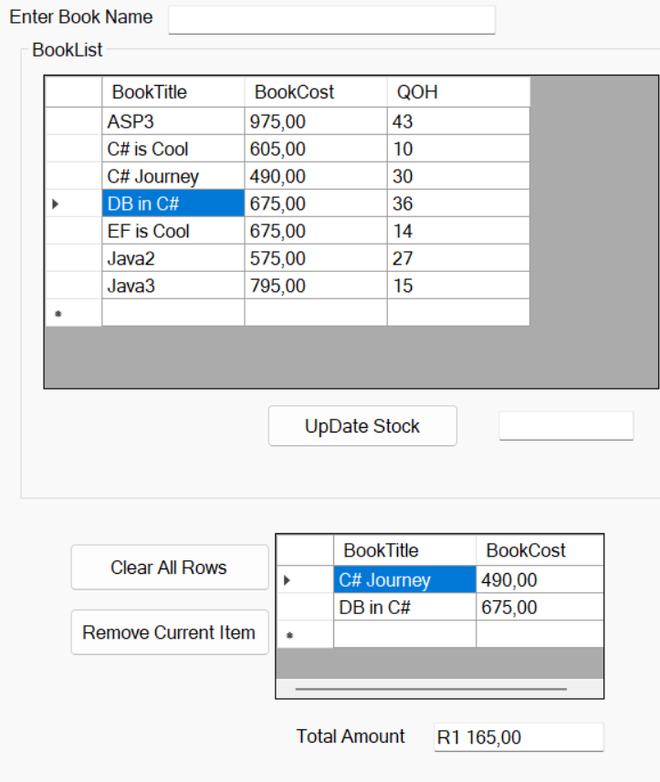
Adding Books to an Invoice
Remember that an Invoice is simply a temporary table – once a transaction is recorded the Invoice Data Table must be cleared up completely
The idea is that the use selects a book (by double clicking the cell content where the book is named – you could also use the row double click as well) and the book is added to the Invoice Table (for this app we will assume that the user can only select a book once only – i.e. the user can select many books but only 1 of each – code is shown below
Also whenever a book is selected the amount owing will be updated
private void dgvBook_CellContentDoubleClick(object sender, DataGridViewCellEventArgs e)
{
DataRow dr;
dr = dsBook1.BkInvoice.NewRow();
for (int i = 0; i < dr.ItemArray.Length; i++)
{
dr[i] = dgvBook.CurrentRow.Cells[i].Value;
}
dsBook1.BkInvoice.Rows.Add(dr);
////txtAmtOwing.Text = getTotal().ToString("C2");
//txtAmtOwing.Text = getTotal().ToString();
}

Slide 12
A Better Version of adding rows to the dynamic Invoice Gridview
The RowHeaderMouseDoubleCLick is a more responsive event handler
Instead of using a loop to iterate though the columns of the current row, you can use the actual names of the columns to fill up the “new row” with records from the datagridview
The code below demonstrates this!
private void dgvBook_RowHeaderMouseDoubleClick(object sender, DataGridViewCellMouseEventArgs e)
{
DataRow dr;
dr = dsBook1.BkInvoice.NewRow();
dr["BookTitle"] = dgvBook.CurrentRow.Cells[0].Value;
dr["BookCost"]= dgvBook.CurrentRow.Cells[1].Value;
dsBook1.BkInvoice.Rows.Add(dr);
txtAmtOwing.Text=getTotal().ToString("C2");
}

Slide 13
Calculate the Total for the Invoice
This code entails iteration through the rows of the Invoice gridview and adding up the sub-totals
private double getTotal()
{
double sum = 0;
for (int i = 0; i < dsBookApp1.Invoice.Rows.Count; i++)
{
sum += Convert.ToDouble(dsBookApp1.Invoice.Rows[i][1]);
}
return sum;
}

Slide 14
Clearing Rows from the Invoice
To clear the current Invoice Row….
private void btnClearCurrentRow_Click(object sender, EventArgs e)
{
dsBookApp1.Invoice.Rows[dgvBookInvoice.CurrentRow.Index].Delete();
txtAmtOwing.Text = getTotal().ToString("C2");
}
To clear all the Invoice Rows….
private void btnClearRow_Click(object sender, EventArgs e)
{
dsBookApp1.Invoice.Rows.Clear();
txtAmtOwing.Text = "";
}

Slide 15
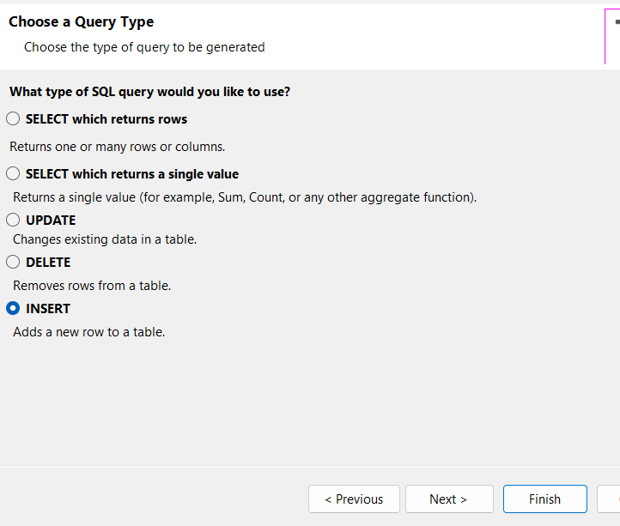
Recording a Sale Transaction
There are 2 parts
Part One is easy – this simply entail recording a Sale into the Order table with the overall Amount, Date and the Order ID that will be system generated
Once this is done the newly inserted OrderID must be returned so that you can record the Order details using this ID
If you right click look at the Order Table adapter, you can add a Sql Insert query; it has an Insert Sql statement that looks like
This statement does one of 2 things – it inserts a new Order into the BookOrder table; OR it inserts a new Order into the BookOrder table and returns the PK (OrderNo) of the newly inserted record. This is done via the Scope_Identity() function that you see in the Sql statement
We will use the 2nd option where the Insertion takes place and the PK of the newly inserted record is returned
INSERT INTO [dbo].[BookOrder] ([OrderDate], [OrderAmt]) VALUES (@OrderDate, @OrderAmt);
SELECT OrderNo, OrderDate, OrderAmt FROM BookOrder WHERE (OrderNo = SCOPE_IDENTITY())

Slide 16
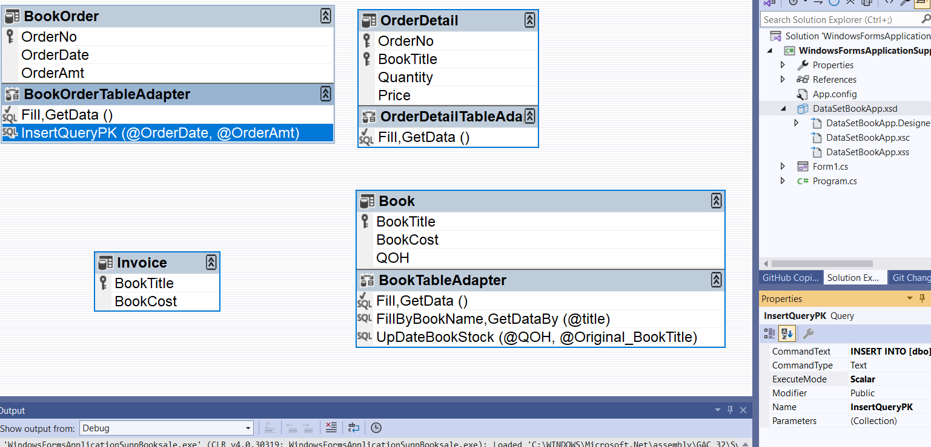
The Configuration
On the InsertQuery of the Order Table Adapter you have to make a few changes:
Change the Execute mode to Scalar
This will ensure that the Scope_Identity () function kicks in and returns the PK of the newly inserted record; in the code, you will need to cast (convert) this value to an integer

Slide 17
The Code to Record the Main Transaction AND the Inner Details - Explanation
The logic goes like this:
The Sale Order consists of many books
First Record the Overall Order
Return the PK of the newly Recorded/inserted order from the BookOrder table
Use this PK to record the details of all the books that formed part of the BookOrder; these details are recorded in the BookOrderDetails table; the PK for each row is a composite PK consisting of a combination of the PK of the overall Order and BookNo of each book that is part of the Order
Since there is usually more than one book in the Order, the recording of each book is done via a looping structure (such as a for loop)

Slide 18
The Code to Record a Sale and return the PK of the New Sale/Order record …and a for loop to record the Inner Detail of the Order
private void btnRecordSale_Click(object sender, EventArgs e)
{
int pk;
DialogResult result = MessageBox.Show("Do you want to Confirm?", "Confirmation", MessageBoxButtons.YesNoCancel);
if (result == DialogResult.Yes)
{
pk = (int)taBookOrder1.InsertQueryPK(DateTime.Now, Decimal.Parse(txtAmtOwing.Text, NumberStyles.Currency));
MessageBox.Show("The Order for a Total Amount of " + txtAmtOwing.Text + "has been Confirmed and the PK is " + pk);
taBookOrder1.Fill(dsBookApp1.BookOrder); //to fill the gridview with the newly recorded order so that it can be viewed
for (int i = 0; i < dgvBookInvoice.Rows.Count - 1; i++) //record the inner detail of the Order
{
string bkID = dgvBookInvoice.Rows[i].Cells[0].Value.ToString();
decimal bkPrice = (decimal)dgvBookInvoice.Rows[i].Cells[1].Value;
taBookOrderDetail1.Insert(pk, bkID, 1, bkPrice); //the default quantity is 1
}
}
}

Slide 19
Things to Take Note of
When a Sale is recorded – the PK is returned…An InsertQuery is executed where the Insert Parameters are the date and the Amount owing – note that Decimal.Parse(txtAmtOwing.text,NumberStyle.Currency) statement is used to extract/remove the currency symbol before the insertion into the databse is made – that is because the AmountOwing field is a Decimal – not a String
pk = (int)taBookOrder1.InsertQueryPK(DateTime.Now, Decimal.Parse(txtAmtOwing.Text, NumberStyles.Currency));
This PK is used to record the inner detail of the Order – i.e.the details of each book is recorded together with the PK of the Order…
Since there is one or more items to record as part of the inner details, a for loop is required…
for (int i = 0; i < dgvBookInvoice.Rows.Count - 1; i++)
The for loop iterates through all the rows of the Invoice Grdiview/DataTable and inserts each row into the Database…
taBookOrderDetail1.Insert(pk, bkID, 1, bkPrice); //the assumption is made that the quantity for the purchase is 1 – we can always change this at a later stage…

Slide 20
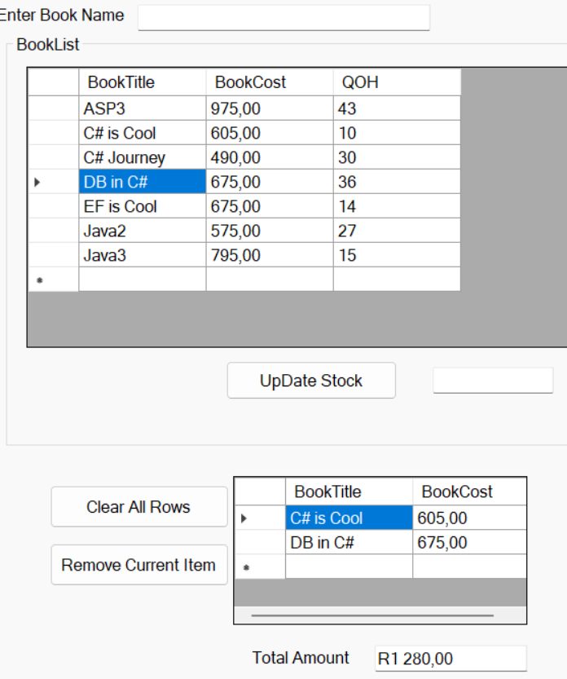
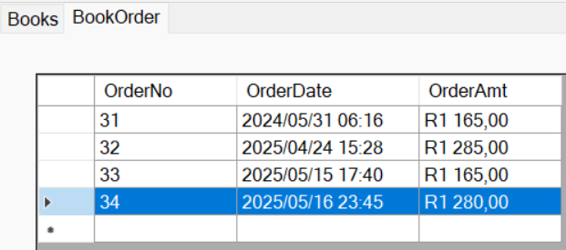
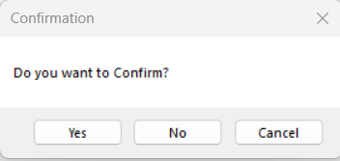
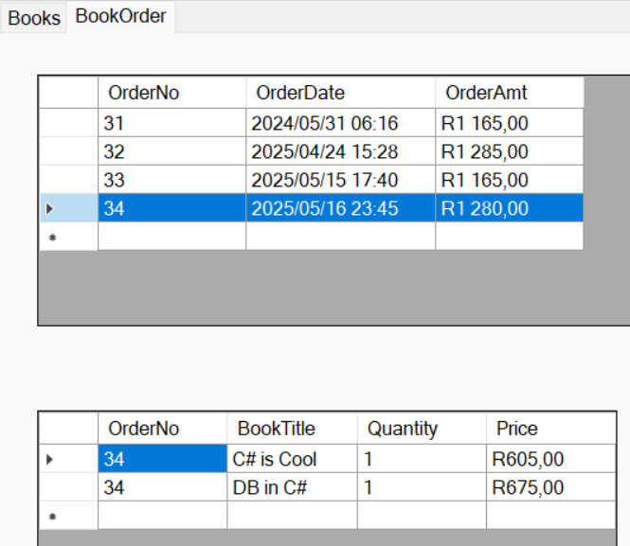
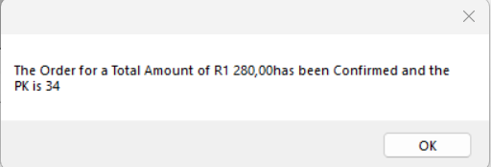
The Visual Sequence
Double click book rows for selection → Fill up the Invoice→ Get the Confirmation → A message to show Sale details appear→ The BookOrder shows details of the New Order→ Click on the Row of the Order → and the INNER DETAILS ARE SHOWN IN THE GRIDVIEW BELOW!!

Slide 21
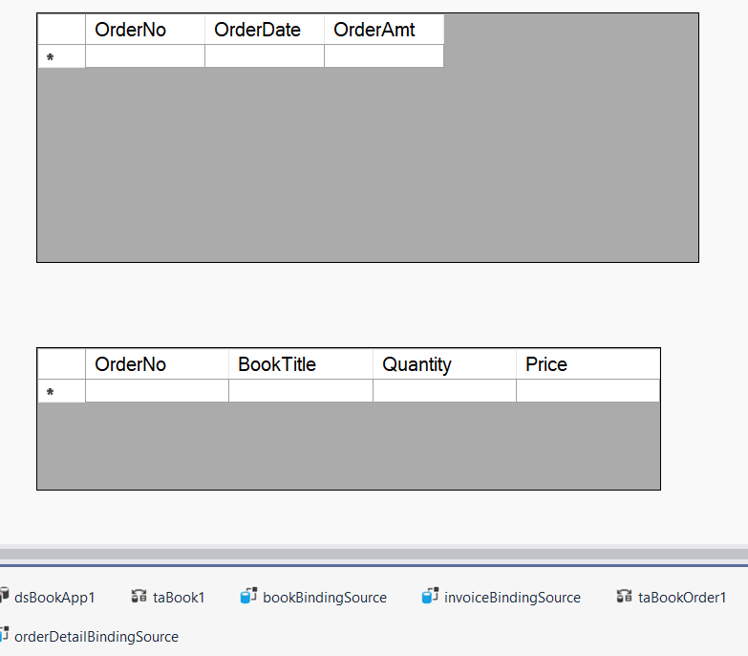
Showing the Inner Details of the Order
This is simply a matter of configuration
The 1st Gridview is linked to the Order Table and filled when the form loads….. taBookOrder1.Fill(dsBookApp1.BookOrder);
The 2nd Gridview is linked to the OrderDetail Table and only gets filled when the user clicks on a row in the 1st Gridview
private void dgvOrder_CellClick(object sender, DataGridViewCellEventArgs e)
{
taBookOrderDetail1.FillByOrderNo(dsBookApp1.OrderDetail,(int)dgvOrder.CurrentRow.Cells[0].Value);
}

Slide 22
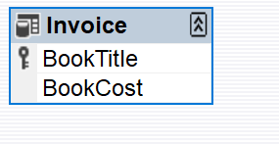
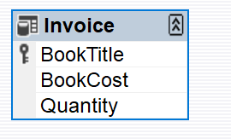

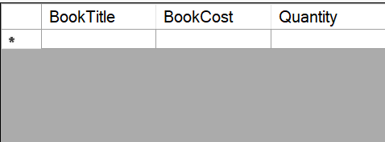
Record of Inner Details is Complete
What if you wanted to enable the user to purchase a quantity greater than one
You can change the Invoice table by adding in a Quantity column
The old Invoice table …and the new one
The old Invoice table …and the new one
Rebuild the application…Reset the data source for the Invoice Gridview and the Invoice Gridview changes from
To a Gridview with a Quantity column

Slide 23
Adding rows to Invoice Gridview with Quantity
When a Book is chosen, the Book Row is added to the Invoice and the Quantity is set to 1
This value can be edited and changed to any quantity value that is preferred…also you need to update the Total calculation by including the Quantity field
Adjustments are required for the code record the sale as well because the quantity value has to be included
private double getTotal()
{
double sum = 0;
for (int i = 0; i < dsBookApp1.Invoice.Rows.Count; i++)
{
sum += Convert.ToDouble(dsBookApp1.Invoice.Rows[i][1])* Convert.ToInt16(dsBookApp1.Invoice.Rows[i][2]);
}
return sum;
}

Slide 24
The code to record the Order with Quantity Included
private void btnRecordSale_Click(object sender, EventArgs e)
{
int pk;
DialogResult result = MessageBox.Show("Do you want to Confirm?", "Confirmation", MessageBoxButtons.YesNoCancel);
if (result == DialogResult.Yes)
{
pk = (int)taBookOrder1.InsertQueryPK(DateTime.Now, Decimal.Parse(txtAmtOwing.Text, NumberStyles.Currency));
MessageBox.Show("The Order for a Total Amount of " + txtAmtOwing.Text + "has been Confirmed and the PK is " + pk);
taBookOrder1.Fill(dsBookApp1.BookOrder); //to fill the gridview with the newly recorded order so that it can be viewed
for (int i = 0; i < dgvBookInvoice.Rows.Count - 1; i++)//record the inner detail of the Order
{
string bkID = dgvBookInvoice.Rows[i].Cells[0].Value.ToString();
decimal bkPrice = (decimal)(dgvBookInvoice.Rows[i].Cells[1].Value);
int bkQty = Convert.ToInt32((dgvBookInvoice.Rows[i].Cells[2].Value));
taBookOrderDetail1.Insert(pk, bkID, bkQty, bkPrice);//the assumption is made that the quantity for the purchase is 1 – we can always change this at a later stage…
}
}
}

